Slide 1

INSURE AI
Online Corporate Insurance using AI
- Sai Nikesh

Slide 2

Outcomes:
Allow Customer to easily schedule appointments with preferred Agents.
Provide Agents with a convenient way to manage their appointment schedules.
Improve efficiency in outpatient appointment booking and management.
Enhance patient satisfaction by offering a seamless and user-friendly interface.

Slide 3
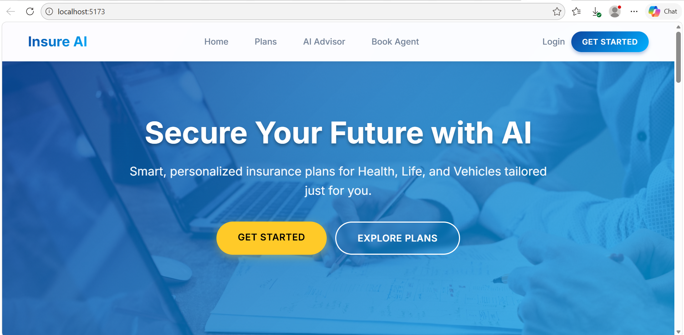
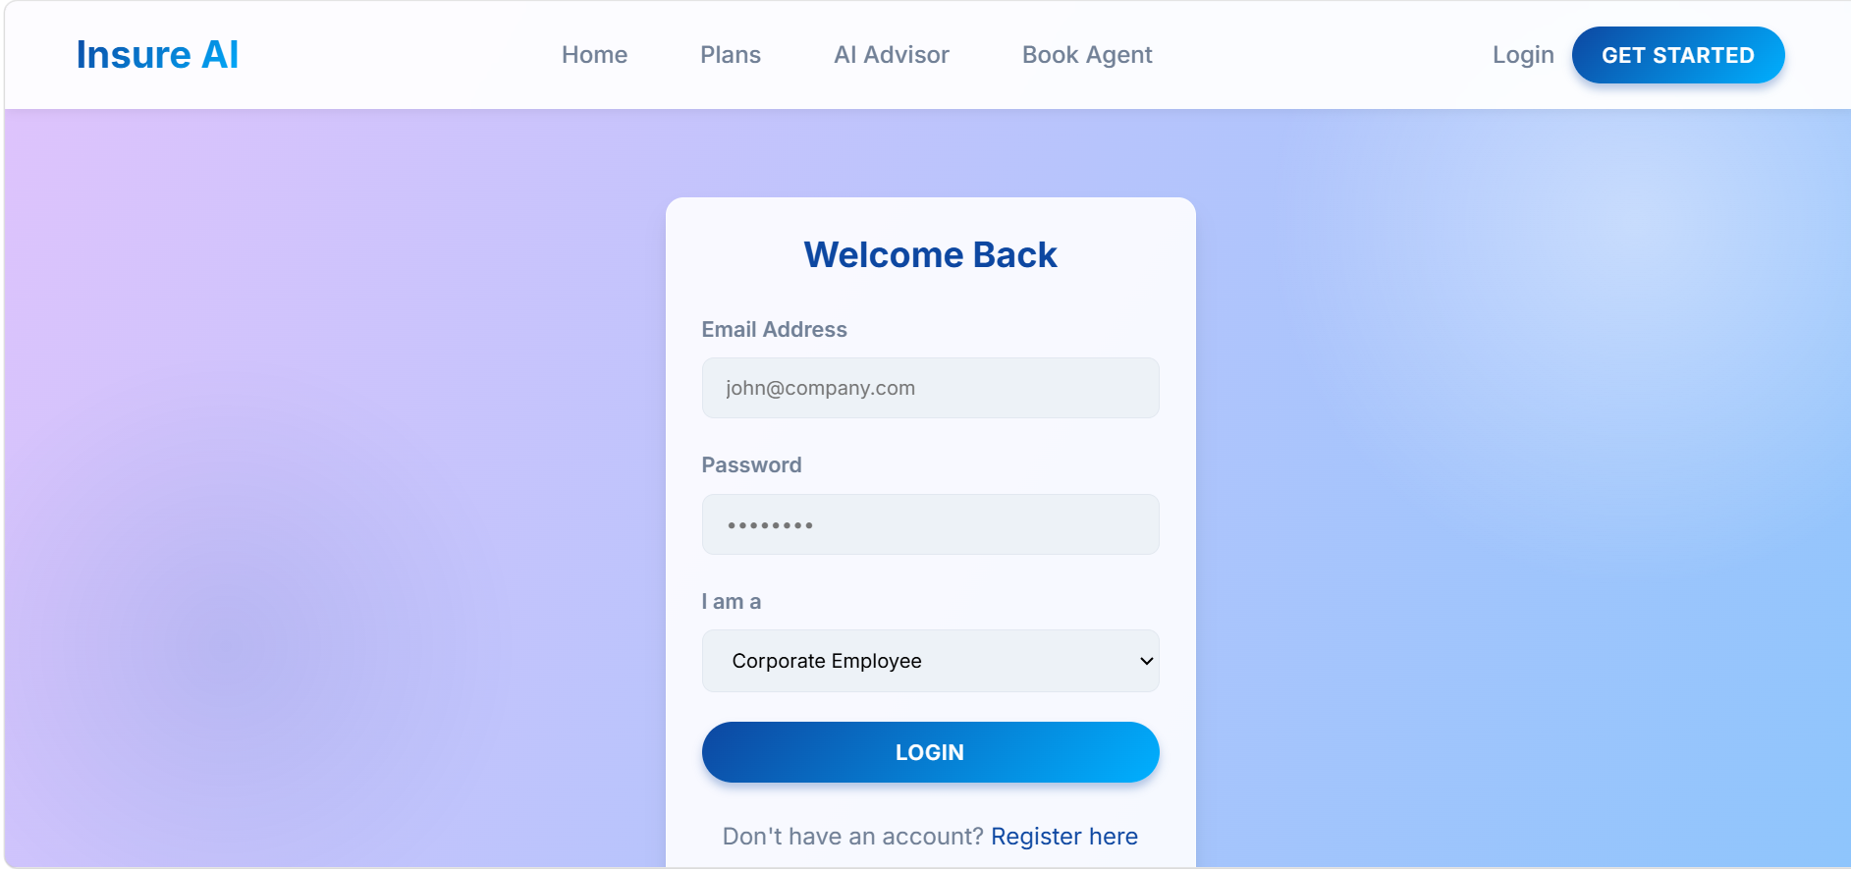
User Authentication and Registration
When the user selects GET STARTED then the user is redirected to the login page .
The User need to Enter his/her details and proceed to login. In case he doesn’t have an account he can create a new account by filling the necessary details.

Slide 4
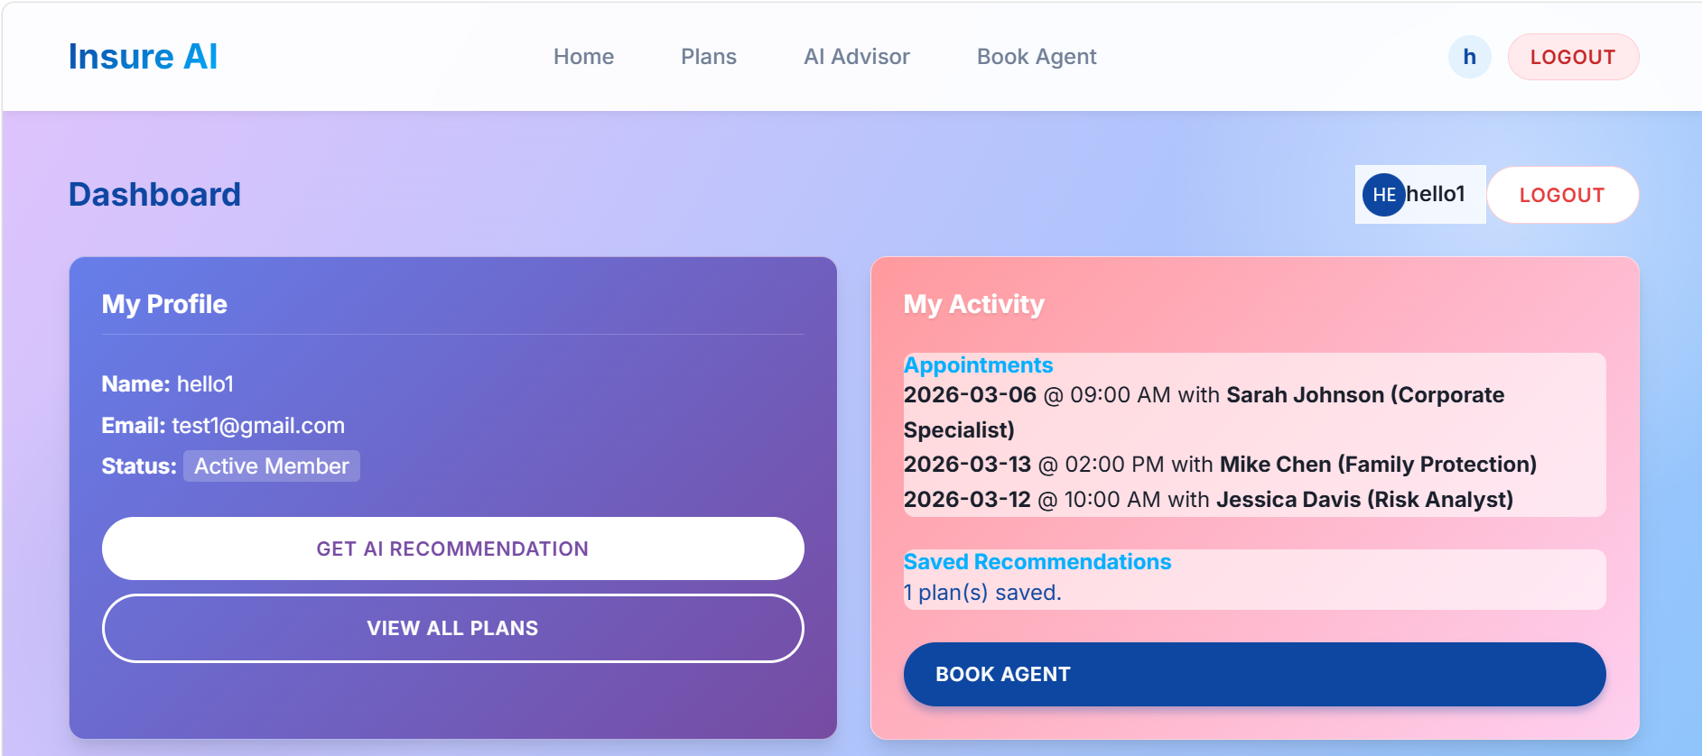
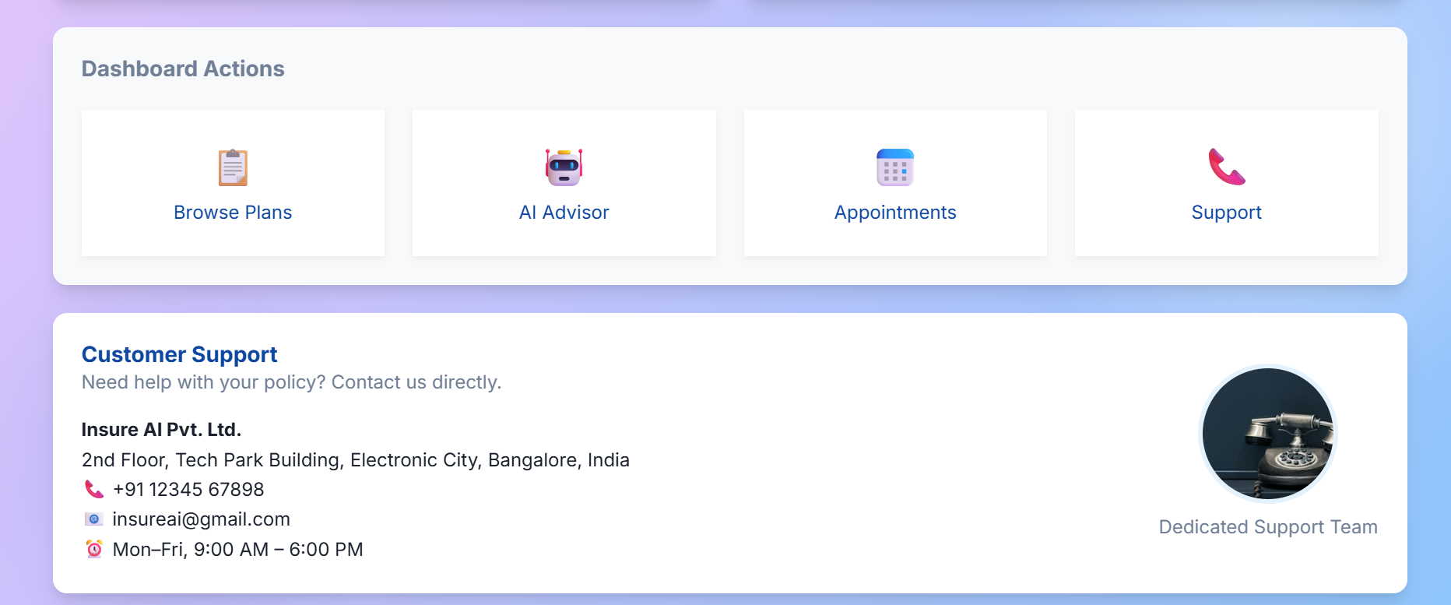
User Dashboard
APPOINTMENT SCHEDULING

Slide 5
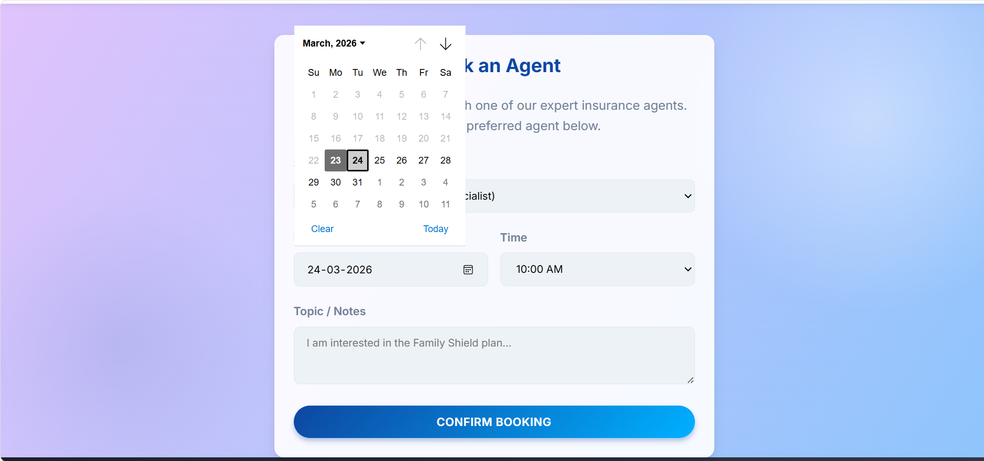
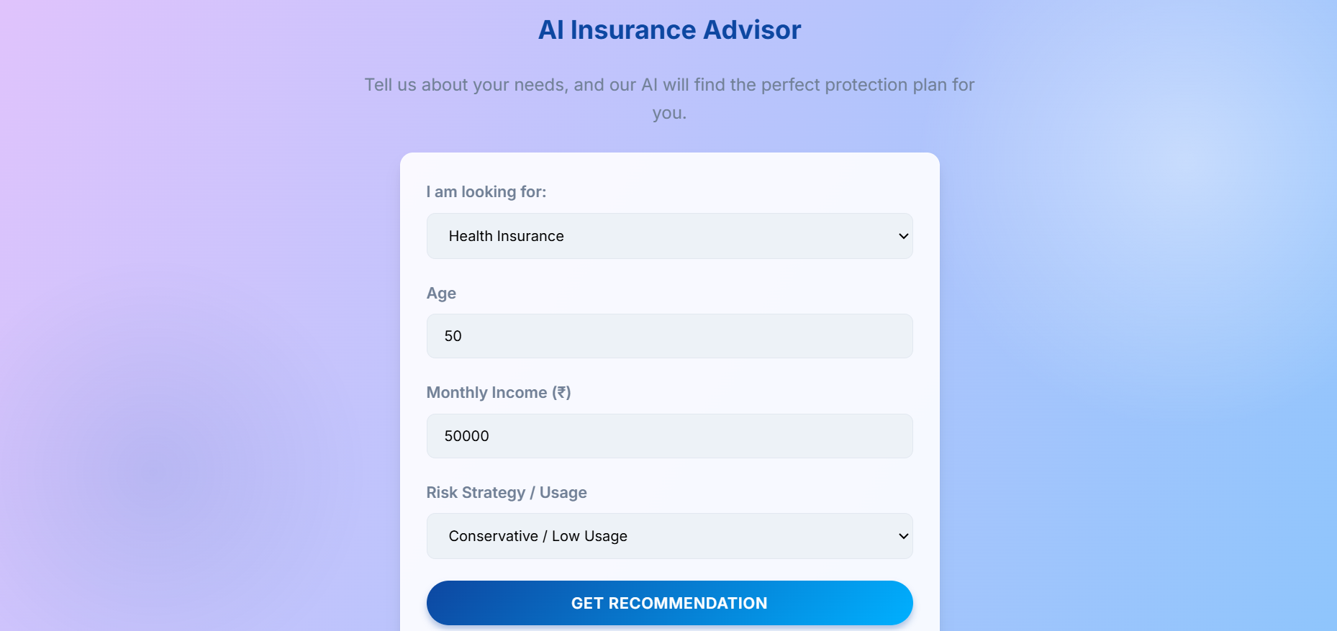
AGENT BOOKING
AI ADVISOR

